Slide 1

Goals Scored: Men vs Women Soccer Matches
Briana Salinas
11/27/23

Slide 2


NWSL VS MLS
National Women's Soccer League
Major League Soccer
First established - 2012
From WUSA
As of 2022- 12 teams have been added
The Women’s World Cup created- exposure for the league
^Backed by MLS
Established- 1966
Due to the bid by the USA-
To host the 1994 World Cup
Considered the highest level – soccer here in the United States
Has grown with exposure to high-level players:
Landon Donovon
David Beckham
Wayne Rooney
Lionel Messi

Slide 3

Hypothesis
NULL: There is no significant difference in goal averages between men’s and women’s soccer matches
ALT: There IS a significant difference between the men's and women’s soccer matches

Slide 4
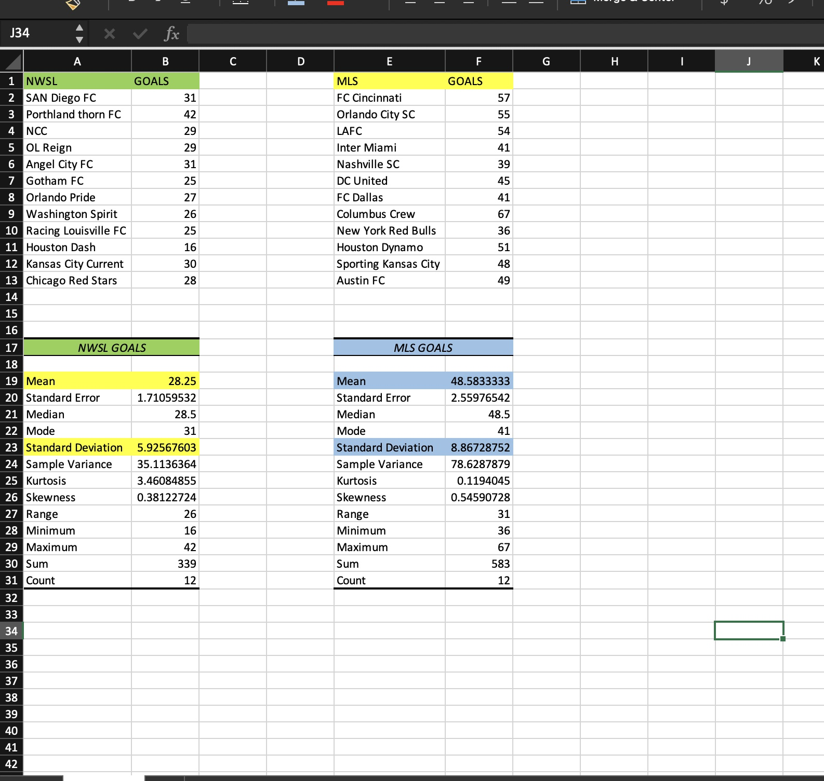
Descriptive Stats- Men’s vs Women’s
I sorted the men’s and women’s soccer goals in separate columns to get the average and standard deviation
To compare the average goals between both the men’s and women’s matches
*The averages/SD can be seen in my results for both sets of data

Slide 5
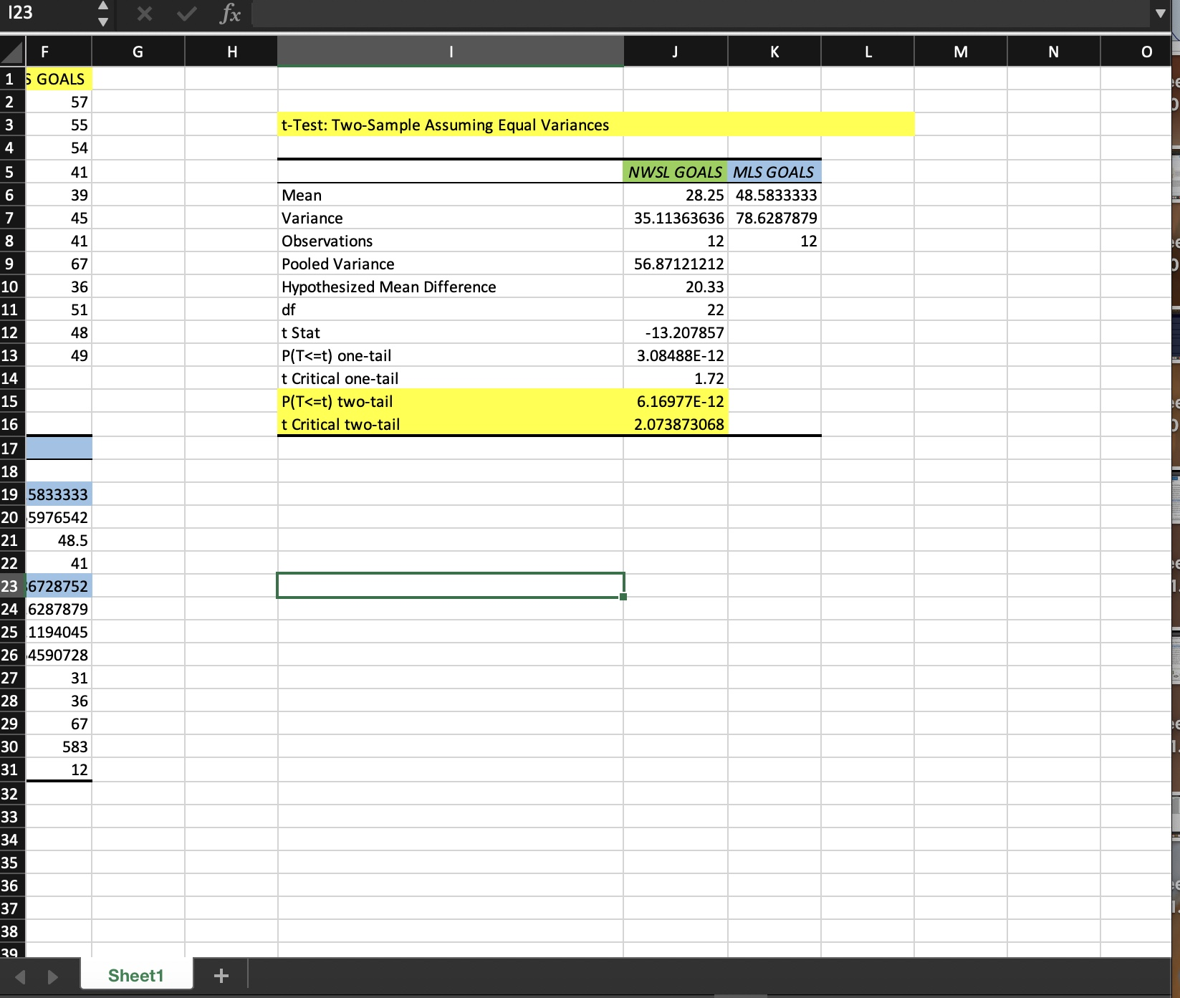
T-Test- Men’s and Women’s Soccer Matches
* I ran the two sampled T-tests w/ equal variances to compare both sets of data
This test was also run to get the p-value, which was 0.00000000000616977 which was < 0.05
This result would mean that the Null is rejected and accepts the Alt.
^ Showing- is a significant difference between goal averages between the men and women soccer matches

Slide 6
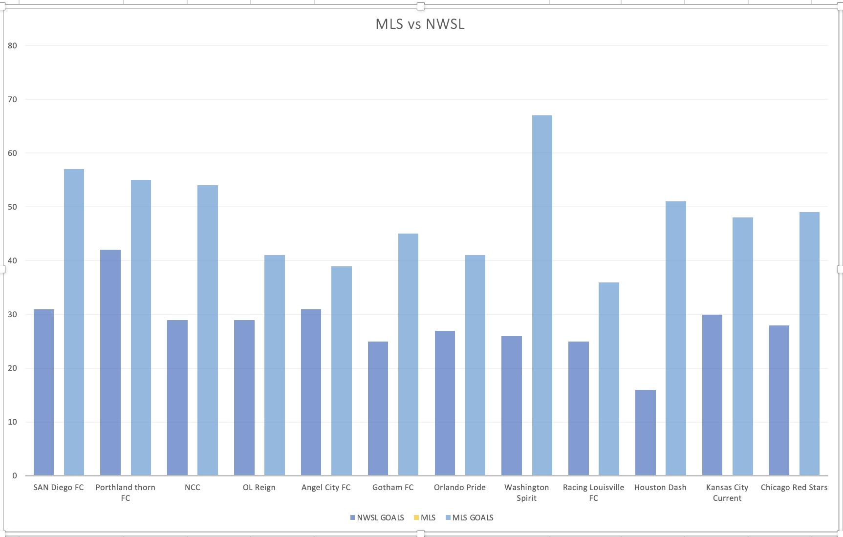
Goal Difference- Men vs Women Soccer Matches
*Just another visual to show the difference between the Men vs Women soccer matches

Slide 7
References
https://www.nwslsoccer.com/about-the-nwsl
https://www.britannica.com/topic/Major-League-Soccer
https://www.espn.com/soccer/standings/_/league/usa.1
https://www.espn.com/soccer/standings/_/league/usa.1

